Slide 1
Data Science and Python
Tyrik Edwards
CTEC 298
Symbolic Computation using Big Data
Fall 2021

Slide 2

Table Of Contents
Introduction
Summary of CTEC 128 paper
Description of CTEC 298 material
Description of the plot deliverables
Summary/Conclusion

Slide 3
Introduction
Data scientists examine which questions need answering and where to find the related data.
Through CTEC 128 and 298 we investigate data science and use of various tools that are used in the data science field.
By using tools like Jupyter Notebook and Python programming language I was able to clean and display my data.

Slide 4
Summary of CTEC 128
The paper covers our decision making when it came to handling our data and what to look for when digging through the data.
Talked about using data ingestion to retrieve our data for the project.
Explained our data wrangling to narrow down our dataset.
The data set consisted of the Stockton, California police stops in 2012-2016. It has the race and age of the civilian. officer ID, reason for stop and search conducted.

Slide 5
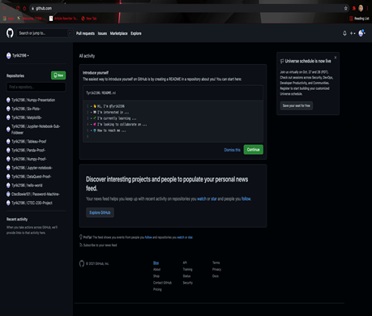
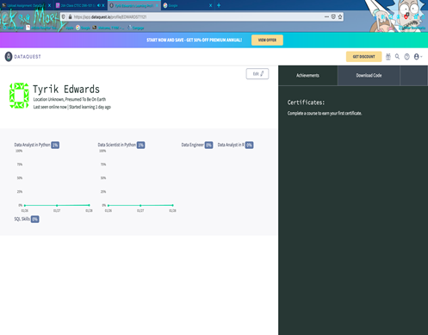
Description of 298 Materials
Throughout the semester I did Dataquest tutorials so we can be more acquainted with Phyton.
I worked on finishing instructional exercises on Matplotlib, NumPy, Pandas and Jupyiter Notebook in order to display the 6 six plots we learned.
I also used GitHub to display our tutorial completion.

Slide 6
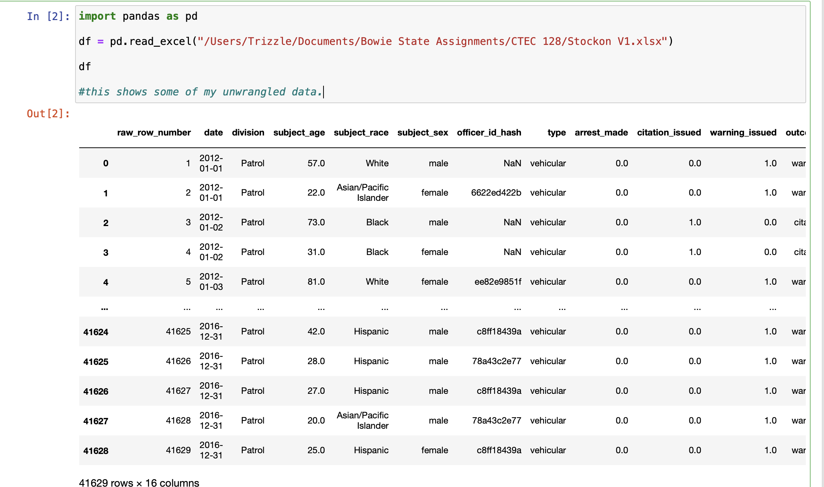
CTEC 128 data set

Slide 7
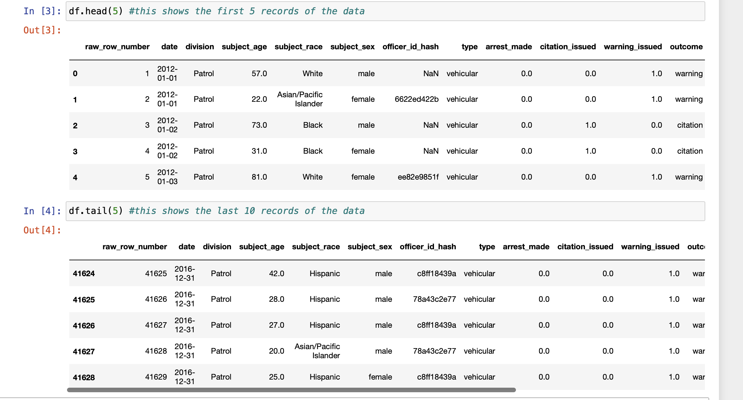
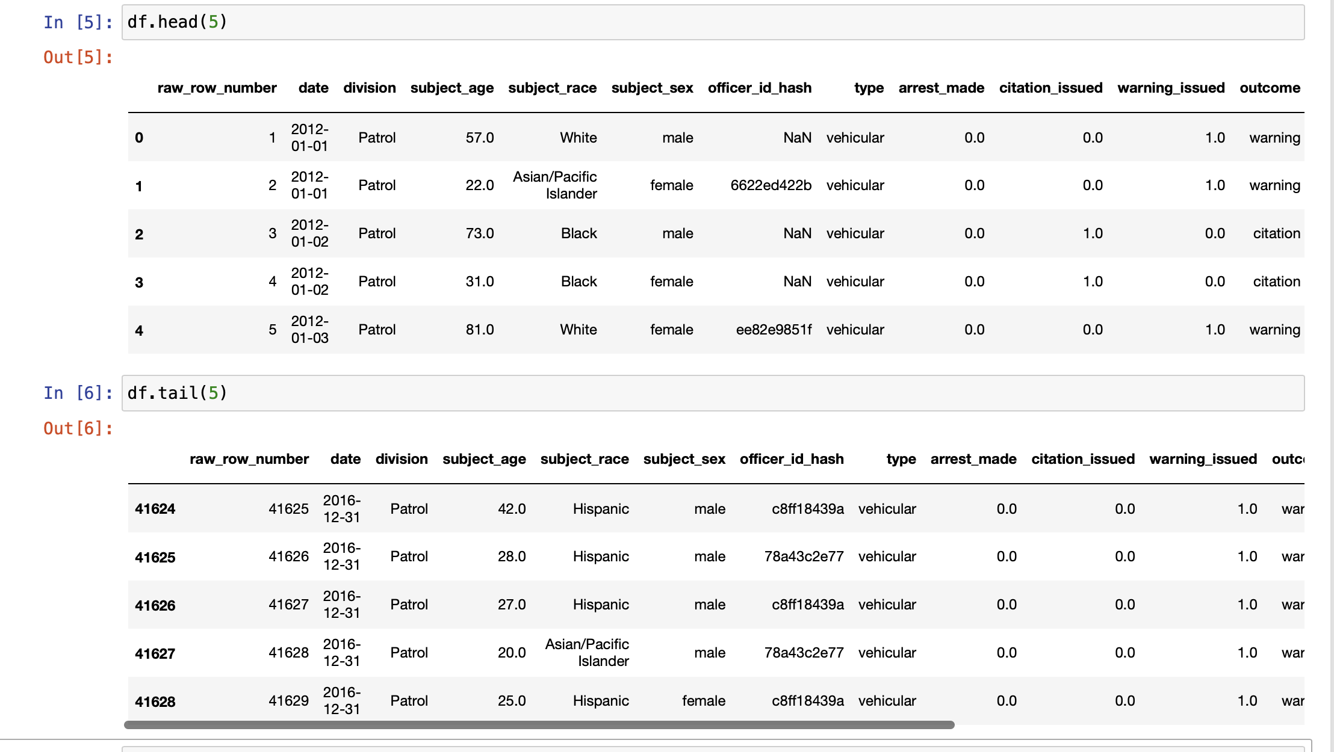
CTEC 128 Dataset
Original Data Set Head/Tail
Wrangled /Clean Data Head/Tail

Slide 8
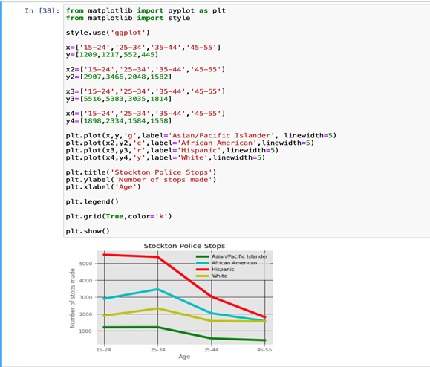
Description of Plot – Line Graph
The line graph to the right displays the number of stops grouped by age and race.

Slide 9
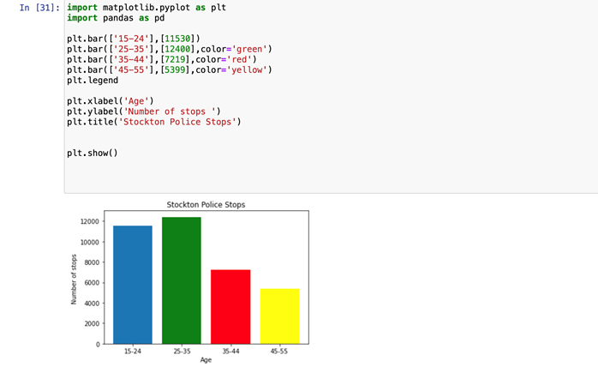
Bar Graph
The bar graph represents the number of stop total by age range

Slide 10
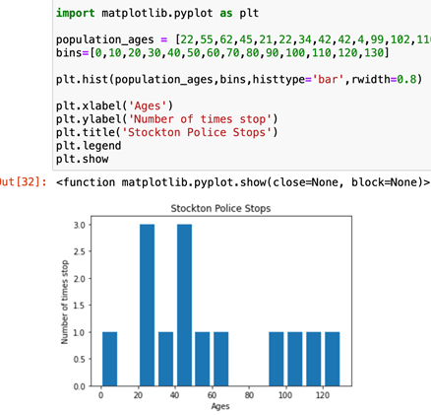
Histogram
The histogram represents the number of stops according to the age

Slide 11
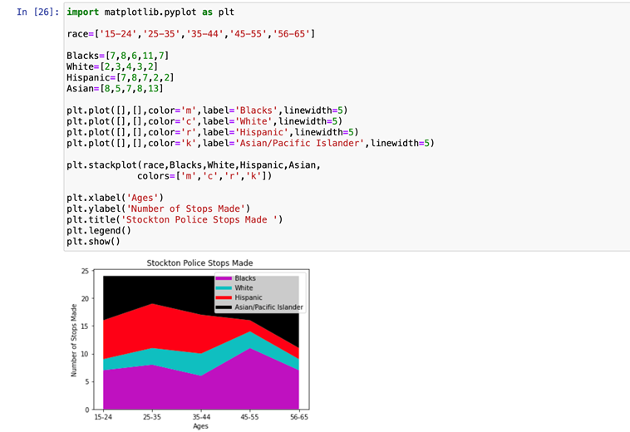
Stack Plot
The stack plot displays the number of stops grouped by age and race.

Slide 12
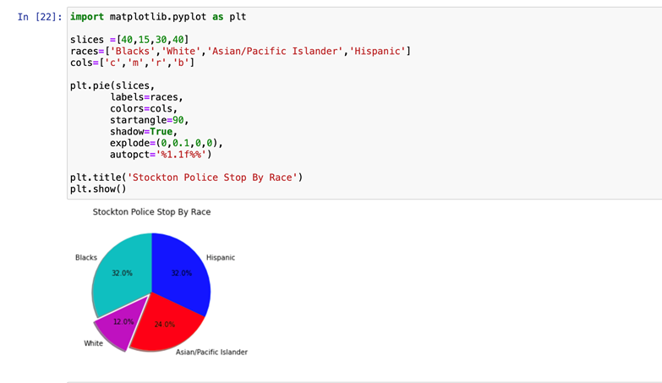
Pie chart/Plot
The pie chart represent the percentage of police stops by the race of the civilian.

Slide 13
Summary /Conclusion
All in all this course developed what we realized in CTEC 128.
We utilized simply dominate and GUI instruments to outline information in CTEC 128.
In CTEC 298 we customized utilizing Python and its libraries to plot outlines and diagrams.

Slide 14
References
Matplotlib
GitHub
City of Stockton, http://ww1.stocktonca.gov/Departments/Police.
US Census Bureau. About the Survey. The United States Census Bureau. https://www.census.gov/programs-surveys/acs/about.html

